Slide 1
Attendance Record System
Aditi Rathore
NIT Bhopal
ECE, 2nd year

Slide 2
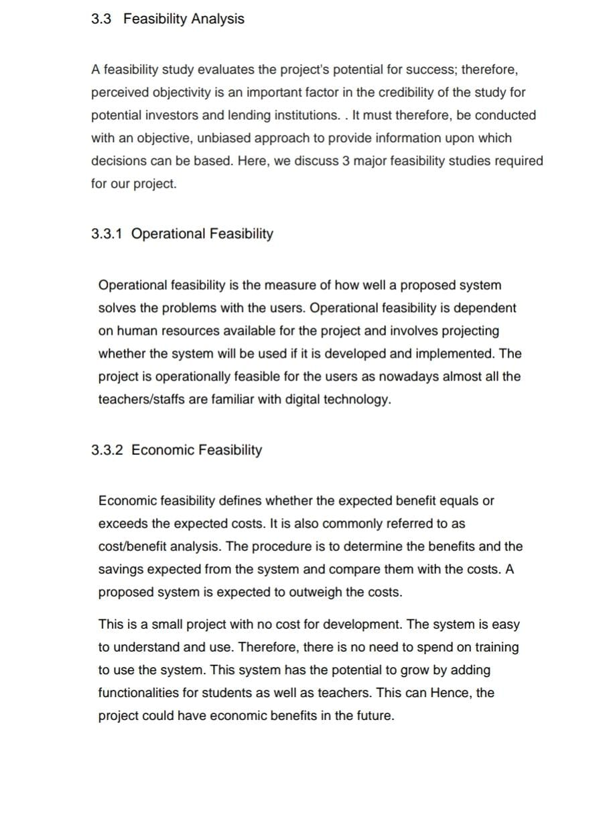

Slide 3
PROBLEM
Face Recognition
Develop a browser-based application or a native mobile application to demonstrate application of Face Recognition technology.
You could choose to demonstrate application of Face Recognition in any area of application of your choice, for example:
Preventing crime
Device security
Smarter advertising
Finding mission people or lost pets
Diagnose diseases
Tracking attendance
Facilitate secure transactions
You are free to choose any Face API you are comfortable with.

